Slide 1


Sentiment Analysis
Project 5

Slide 2
Project Objective
This project aims to analyze customer’s opinions on Twitter, to classify or understand public opinion and emotional tones. The project also aims to design a machine learning model fitting its parameters to training data, using an optimization procedure, and then using it to make predictions about unseen data.
Project Goals:
Analyze customer’s opinions on Twitter about some airlines.
Identify patterns in sentiment and emotional tones.
Develop a machine learning model to make predictions about unseen data.

Slide 3
Data Preprocessing
Where applicable, numerical columns were converted from int to float types
01
Columns with empty values were deleted
02
Date fields were converted into datetime format
03

Slide 4
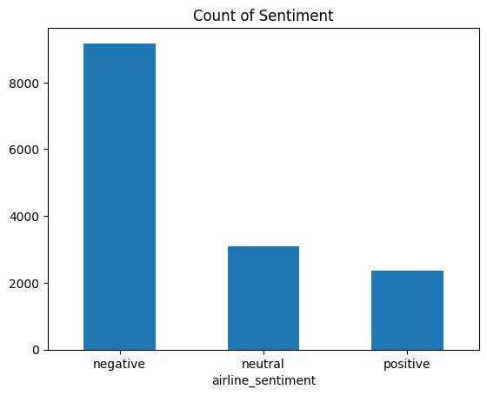
Exploratory Data Analysis
As expected in social media, negative comments ad feedbacks were majority

Slide 5
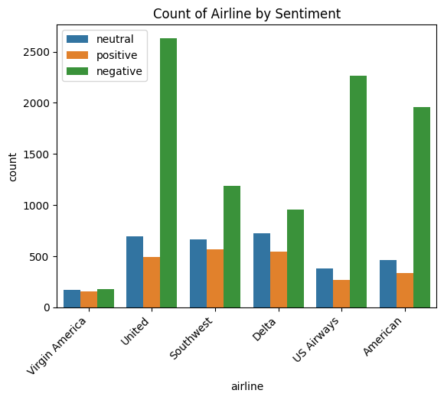
Checking sentiments for each airline
The discrepancy in the negative sentiment about United, US Airways and American Airlines is eye-catching.

Slide 6
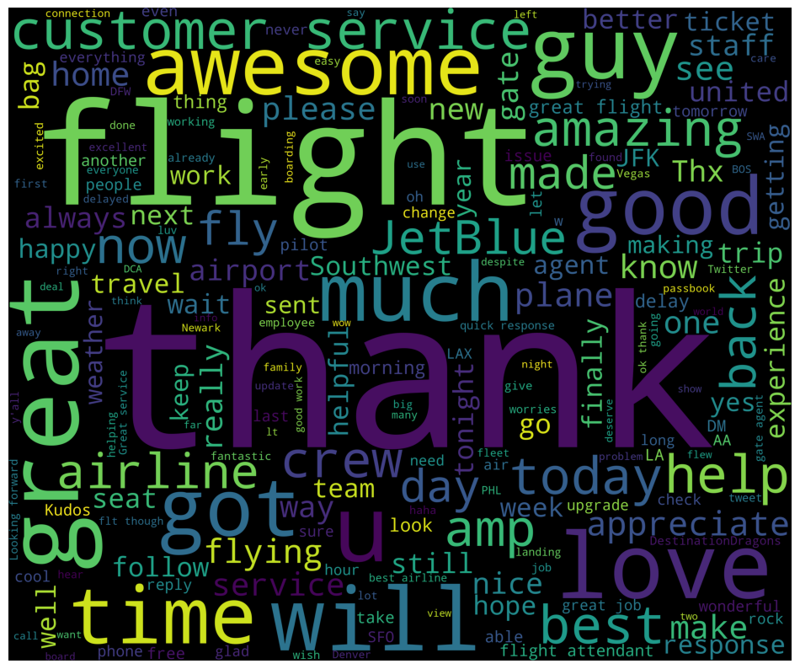
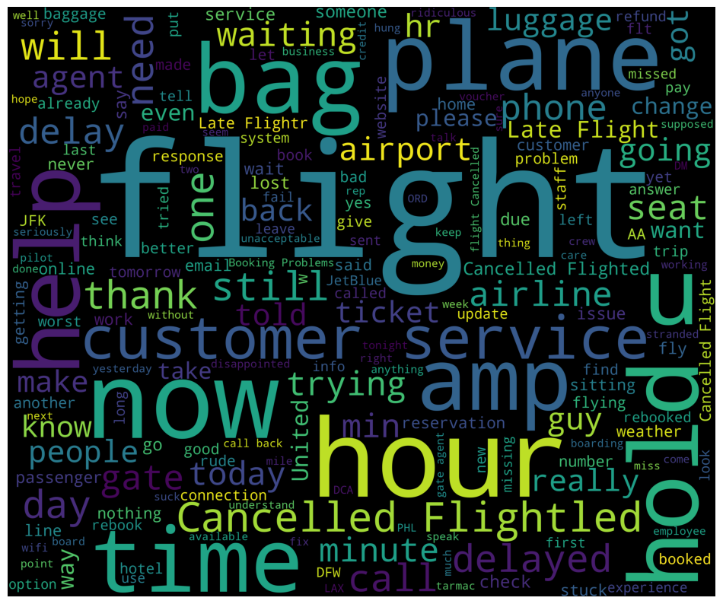
Word cloud comparison positive- negative sentiment
Positive
Negative

Slide 7
Machine LEarning approach
Also known as Document Classification
Uses ML algorithm to classify the text data

Slide 8
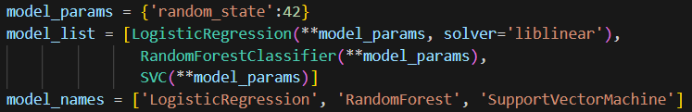
Model Setup
Defines three models with a fixed random state for reproducibility and associates them with names for tracking results

Slide 9
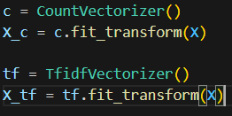
Feature Engineering
Transforms the text data (x) into numerical formats using two methods:
CountVectorizer (X_c): Converts text to a bag-of-words representation.
TfidfVectorizer (X_tf): Converts text to a term frequency-inverse document frequency representation.

Slide 10
Cross validation
Uses Stratified K-Fold with 5 splits to ensure balanced representation of sentiment classes in training and validation folds.

Slide 11
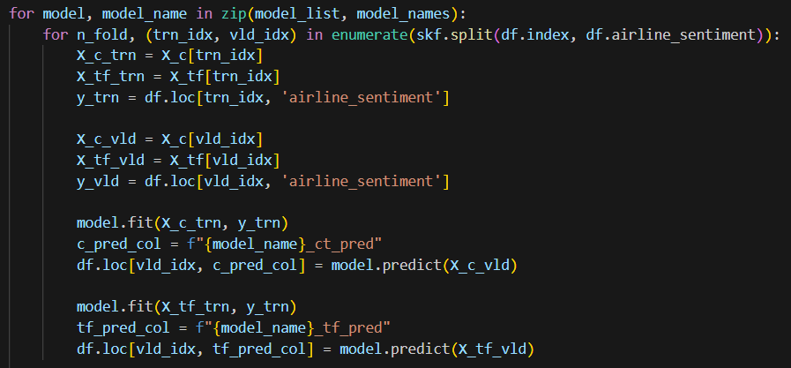
Model Training and Predictions
Trains each model on both the CountVectorizer and TfidfVectorizer features for training data (trn_idx).
Predicts sentiment for the validation data (vls_idx)
Stores predictions in new columns of the dataset, dynamically named for each model and vectorizer combination (e.g., LogisticRegression_ct_pred).

Slide 12
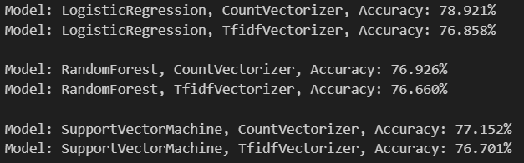
Evaluation
Computes and prints accuracy scores for each model-vectorizer combination using the entire dataset and corresponding predictions

Slide 13

This process allows for a detailed comparison of how each model performs with different text vectorization techniques, providing insights into the best model and feature representation for sentiment analysis.

Slide 14



Recommendations
Use the identified dates with spikes in negative sentiment to anticipate future issues (e.g., during peak travel seasons or after major disruptions) and implement proactive measures.
Create marketing campaigns using common positive keywords from the word cloud to align with customer expectations and sentiments.
Investigate the specific causes of negative feedback and develop targeted strategies to address these pain points.

